Slide 1
Prospex: Broadening Tech Career Horizons
Notes:
hello everyone we are prospex and we have built a solution to broaden career horizons for uchi students
Potential questions:
Have you guys tested the accuracy of the algorithm? Why choose this algorithm (KNN)?
What are you guys planning to go into yourselves?
How are you going to broadcast this platform to UChicago students?
Can you talk more about how current UChicago students would get resources currently?

Slide 2
1.
Problem
Lack of Exposure to Different Career Paths
Notes:
The problem that we’re tackling is UChicago students’ lack of exposure to different career paths

Slide 3
Lack of Exposure to Different Career Paths
Narrow focus on a few career opportunities
Not enough visibility and resources for other roles
Difficult to find a community to talk to about non-mainstream roles
Notes:
Going through college at UChicago, most of the tech community around you are grinding Leetcode for a software engineering internship. As a group, we’ve realized that we rarely hear anyone going into roles like product management or UI/UX.
Personally as a leader and mentor in several tech and startup clubs on campus, when I introduce these roles to students, almost all of them don't know what they are. After running career awareness workshops or mentorship sessions, I’ll get people reaching out to learn more about these different career paths. It’s not that people are not interested in these other career prospects, its that we have a fundamental lack of exposure to them.

Slide 4
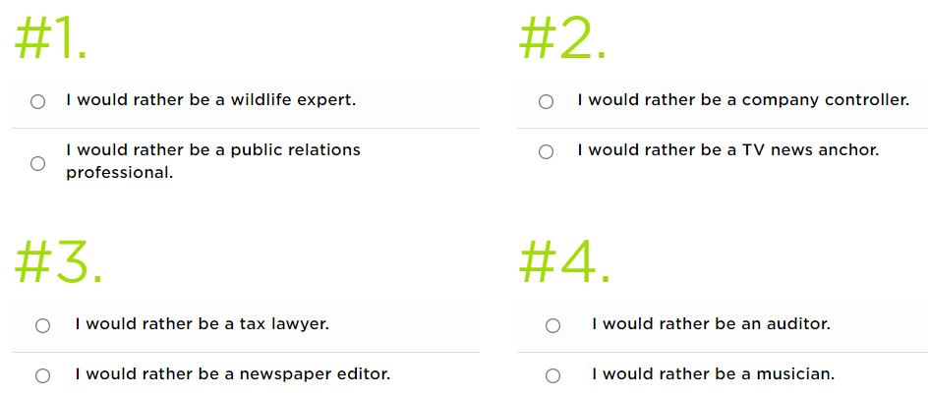
Career Quizzes are NOT the Solution
Too broad to be useful
Confirms existing biases
Princeton Review Career Quiz
Notes:
So why not just take a career quiz? General problems we’ve seen from researching them are that they’re way too broad to be useful, and are not tailored to the student’s area of study. You can see an example of one from a rather reputable source, Princeton Review. Many career quizzes ask you to pick an option from a list of careers, but you can’t answer these questions without just confirming your existing biases.

Slide 5
Why Personality Quizzes are NOT the Solution
Fundamentally not related to careers
Provides little support for career goals
More detailed/helpful ones behind a paywall or for corporate clients
Notes:
Why not personality quizzes either? Because most of the ones we can access provide little support for career goals. Most of the more helpful ones are behind a paywall or for corporate clients.

Slide 6
Proposed Solution
Gamified environment with career-oriented personality questions
provide resources and a community
Notes:
Our proposed solution to this problem is to create a gamified environment for students to discover career paths that they have not seen before, and to provide them with the resources and a community for those paths

Slide 7
Initial Career Fields
Product Management
UI/UX
Quantitative Finance
Tech Startups
Academia and Research
Notes:
For the first iteration of the platform, we are doing five career fields

Slide 8
Data Collection
Surveyed professionals in the fields
Received over 80 responses
Responders came from:
UChicago communities
Young professionals’ networks
Interviewed people directly in product, UI/UX, and academia/research
Notes:
In order to obtain data for our algorithm, we created a short Google form to survey professionals in these fields: the same questions in the Google form are used in the platform itself
Managed to receive over 80 responses in the short period of time we had by reaching out to UChicago communities including the CS department, and other young professional networks
In addition, for friends and family or professionals that we knew well, we interviewed them directly to obtain clearer information and assist in our questionnaire-making process

Slide 9

2.
Implementation
Gamified interactive environment
Notes:
Now, we will show a demonstration of the game we made.

Slide 10
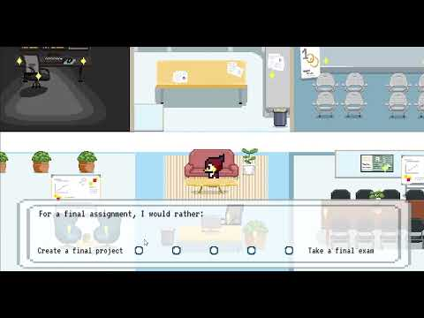
Demonstration
Notes:
In this demonstration, the user controls Phil the Phoenix. You can either choose to walk or teleport to the 16 different questions spread about the screen. After answering all the questions, a portal will appear. Based on your answers, the following scene will display a recommended career choice and a brochure containing additional information about the career.

Slide 11
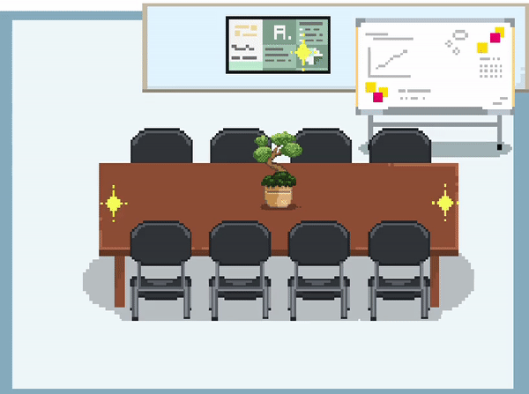
Why a Game?
Designed platform for students at the University who want to pursue a career in tech
Games as a medium allow for interactive experience
Memorable, Shareable, Evocative
Notes:
So, why a game over a standard questionnaire? With this platform, we wanted to introduce a sense of embodied presence into taking career surveys, which can feel quite abstract and impersonal when you are just scrolling by question after question. In contrast, games have the ability to be visually evocative, that is, they can call forth the player's associations with a certain setting or they can generate a story around an unfamiliar space. So for instance, we can imply to the player that PMs will spend a lots of time engaging with people through the visual of a meeting room. In order to achieve this effect, we personally designed all of the assets in this game and tailored them to evoke the atmosphere of certain careers. By navigating through the questions in a tangible environment with a character you can begin to identify with, we hope that this experience is visually and interactively engaging, making it more memorable, more shareable, and more personal.

Slide 12

Platform Implementation
Students navigate the game environment with Phil the Phoenix
Answer questions curated from data collection process
K-Nearest-Neighbors Algorithm provides career path suggestions and relevant resources
Notes:
The earlier demonstration showed how the user experiences our product. However, I will now explain the algorithm behind choosing a career path for the user. The algorithm we used is called K-Nearest-Neighbors. A quick breakdown is we found the Manhattan distance between the user’s inputs and each of the training samples we received from the survey. Finally, we would classify the user as whichever career choice was most common amongst the 11 closest neighbors from the training data. We decided upon k = 11 and the Manhattan distance for our parameters using cross validation with our training data.

Slide 13
3.
Next Steps
Plans for moving forward

Slide 14
Roadmap
Current version of the platform and algorithm
Add more career paths
Create a login system for students to create profiles
1
3
5
2
4
6
Collect more data
Fine-tune algorithm with test participants
Build a community platform for users to interact on
Notes:
We are currently here (point to number 1). Biggest priority right now is to obtain more data, including conducting more interviews to obtain more qualitative data to create better questionnaires. Moving forward, we would add more career opportunities and fine tune the algorithm. In the long run, we would like to facilitate community-building among the students through a login system and create a platform for users to interact with each other. We hope that in the future, our platform will foster a community of students interested in various areas.

Slide 15
4.
Team
How the solution became possible

Slide 16



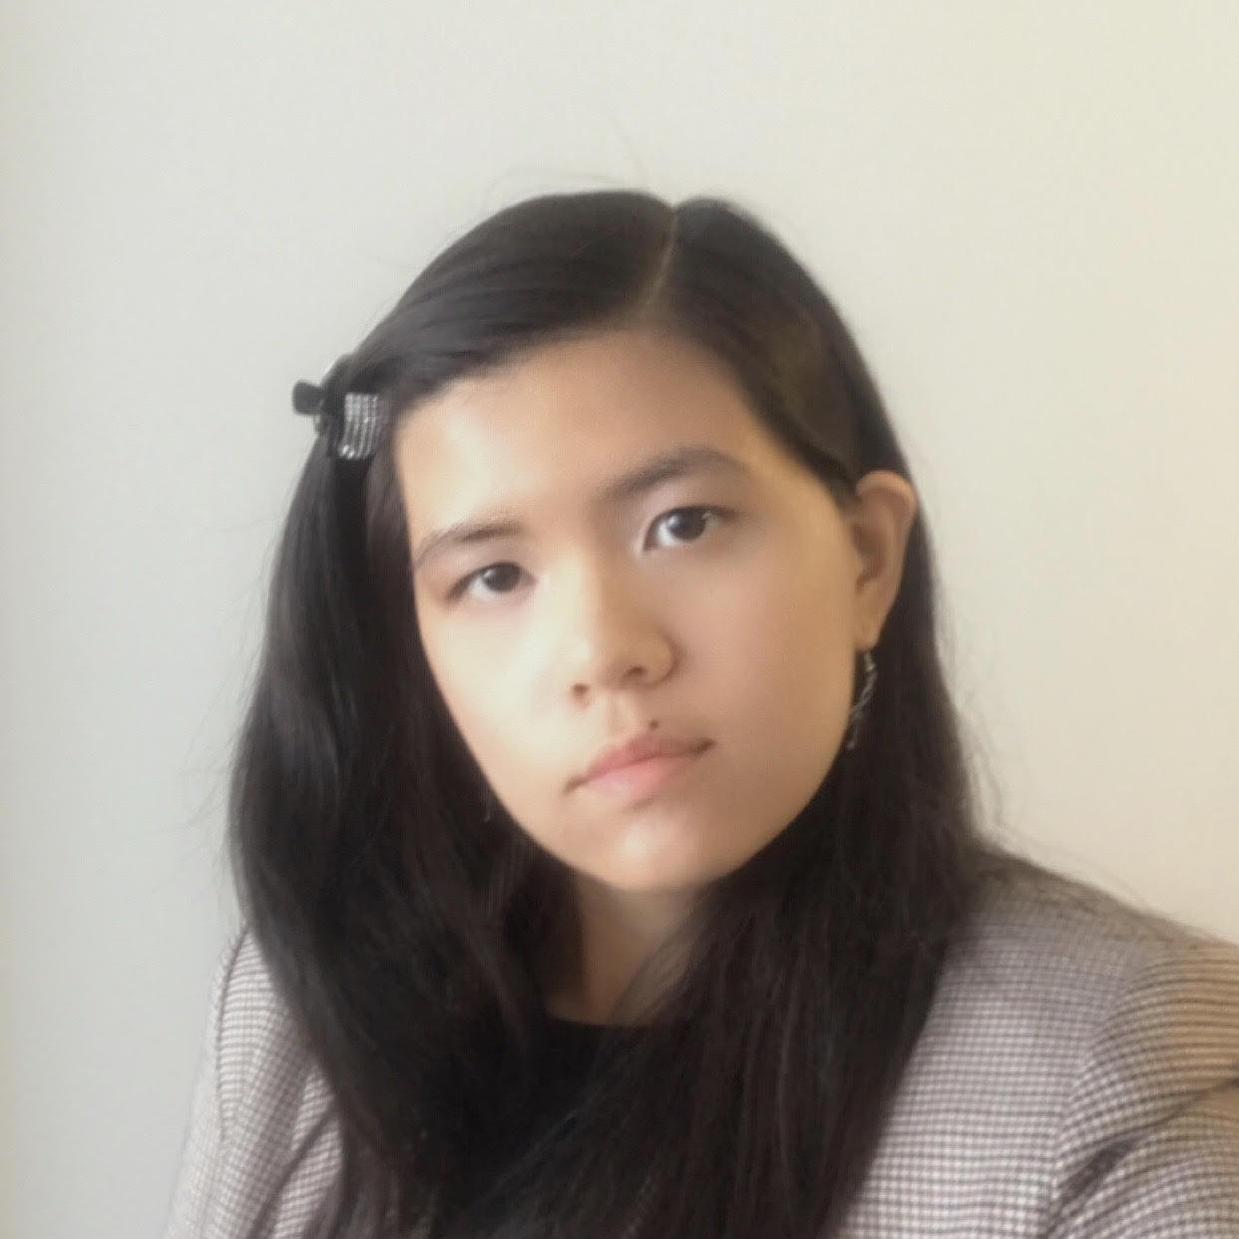
Team Members
Anke Hao Team Lead + Developer
Computer Science + Psychology
2023
Emily Cheng Game Designer + Pixel Artist
Media Arts & Design + English
2023
Max Chou Developer
Computer Science + Statistics
2024
Catherine Charles Content Researcher
Computer Science + Economics
2023

Slide 17
5.
Questions?

Slide 18
6.
Appendix

Slide 19
Survey Snapshot: Product Management
People in Product tend to:
be best at switching different roles within a group
present using visual representations
prefer final projects over final exams

Slide 20
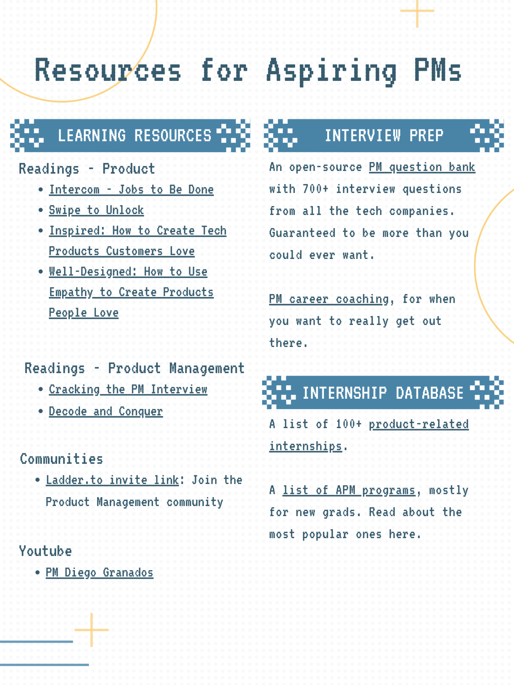
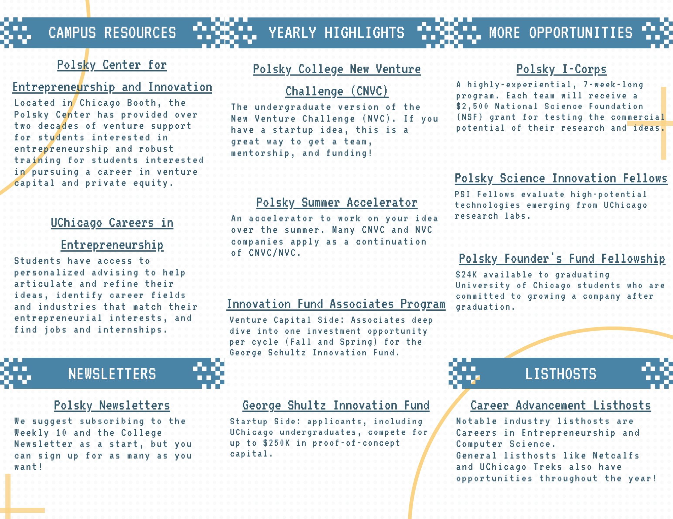
Resource Snapshots

Slide 21
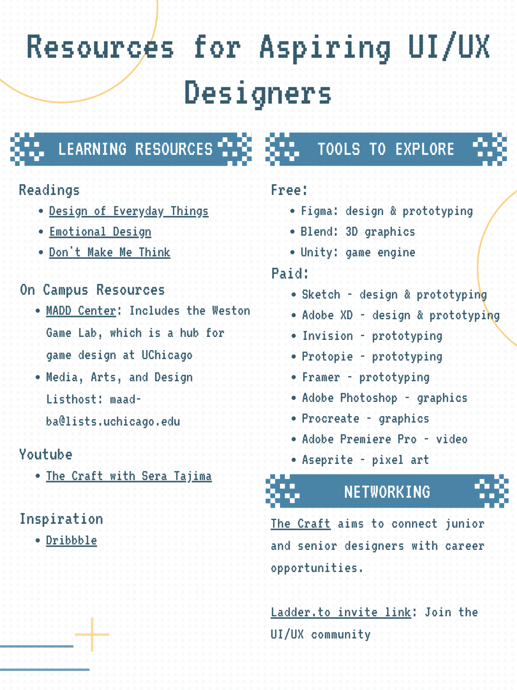
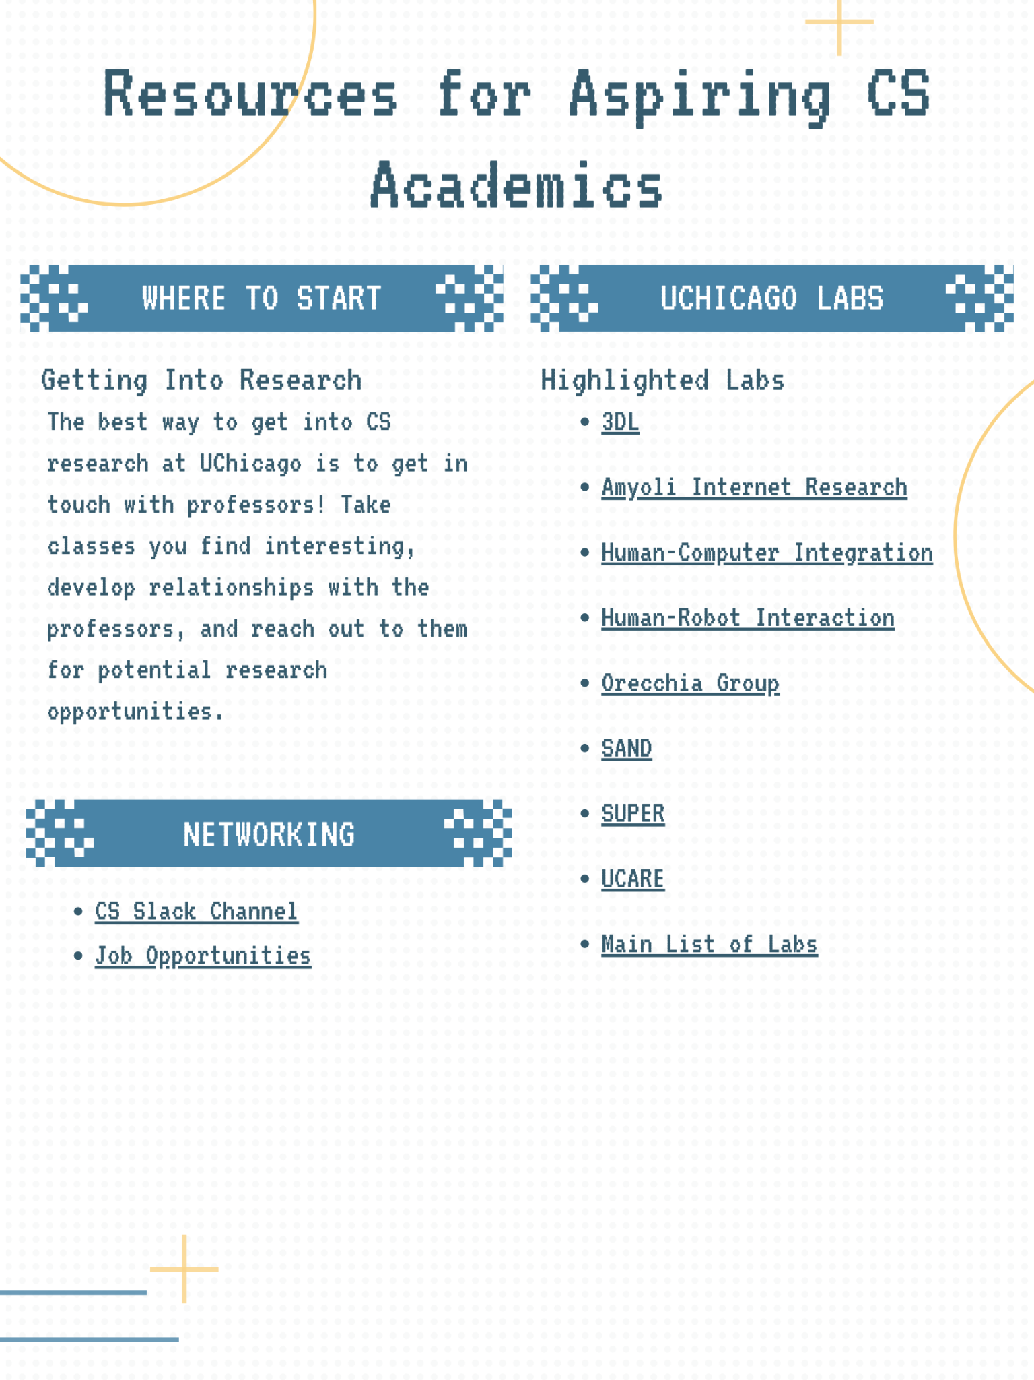
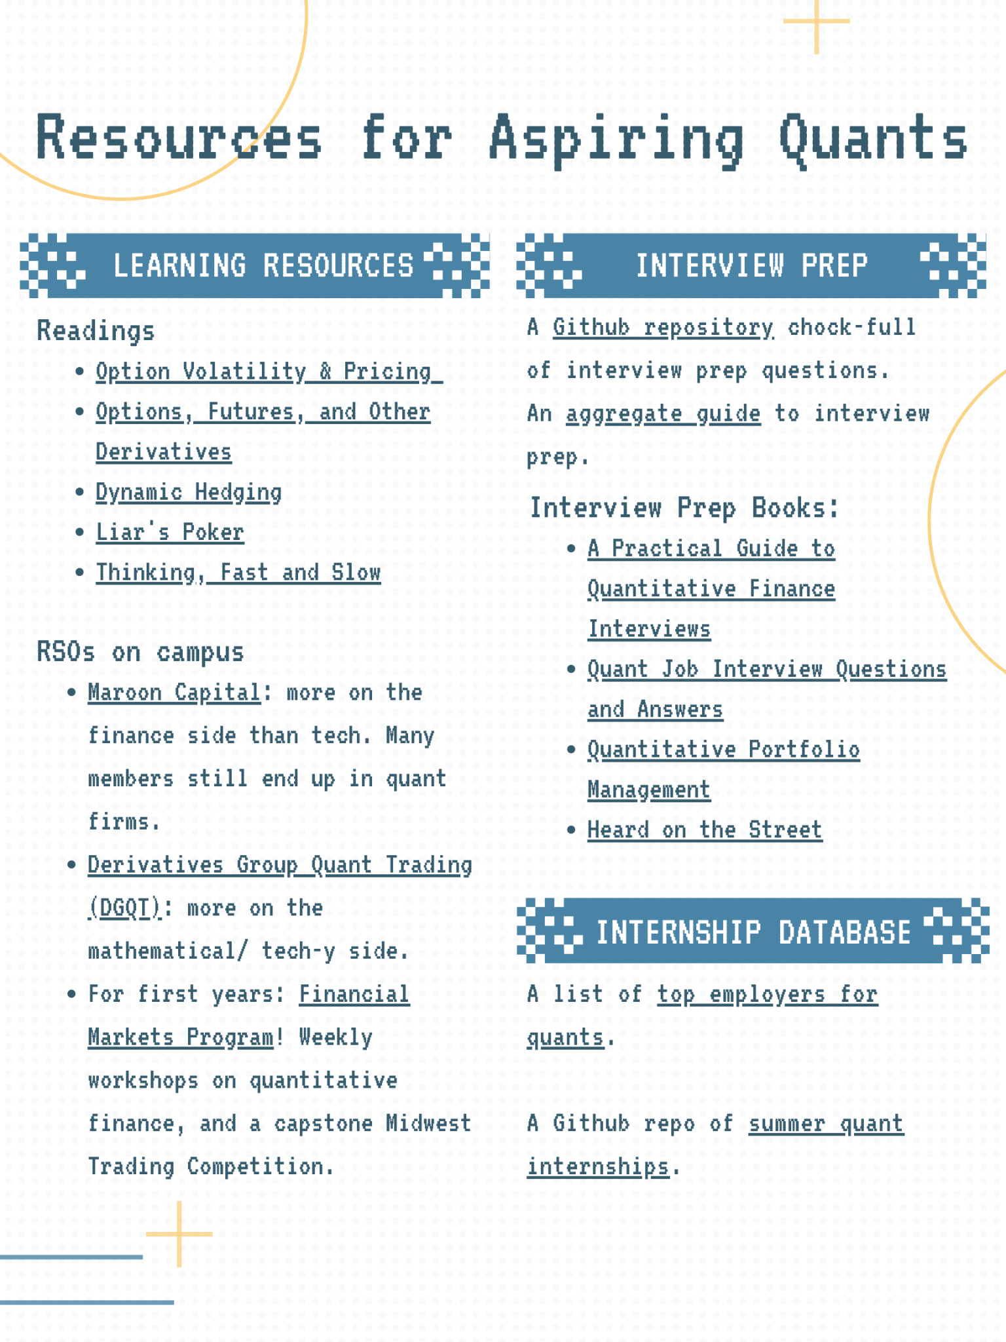
Resource Snapshots

